Slide 1
DATA 607-FINAL PROJECT
Analyzing 311 SERVICE REQUESTS

Slide 2
PROJECT SOPE
This project analyzes NYC 311 service request patterns to identify geographic disparities in complaint types and response times across boroughs, using statistical analysis, Random Forest modeling, and an interactive Shiny dashboard to support data-driven municipal decision-making.

Slide 3
Problem & Big Picture
Rising Service Demand: Public demand for non-emergency services has grown annually since 2019, reaching over 3.4 million requests in 2024, with a heavy concentration on quality-of-life issues such as illegal parking and noise.
Addressing Data Limitations: Because raw data can be skewed by a small number of individuals making high-volume repeat requests, the new NYC311 Monitoring Tool analyzes trends at a neighborhood level to isolate genuine areas of high demand.
Uneven Distribution of Issues: The bigger picture reveals that service needs are not distributed evenly; specific neighborhoods experience disproportionately high rates of complaints regarding housing maintenance and street conditions.
Shifting to Targeted Solutions: City agencies could use geographic hotspot analysis and complaint frequency modeling to proactively allocate resources and address root causes before repeat complaints occur.
Aligning Resources with Need: Thisdata-informed framework allows officials and the public to better align fiscal resources and operational planning with the specific, localized needs of New York City residents.

Slide 4
Problem & Big Picture
Problem Scale
NYC received over 3.4 million 311 requests in 2024, driven by quality-of-life issues
like illegal parking, noise, and housing maintenance.
Disparity
Per-capita, neighborhood-level analysis reveals uneven service needs—communities in the Bronx and Downtown Brooklyn face disproportionately high rates of housing and street-related complaints.
Shift Needed
Moving from reactive complaint processing to targeted, data-informed resource allocation can address root causes in the most affected areas.

Slide 5
Using visualizations to understand 311 data

Slide 6
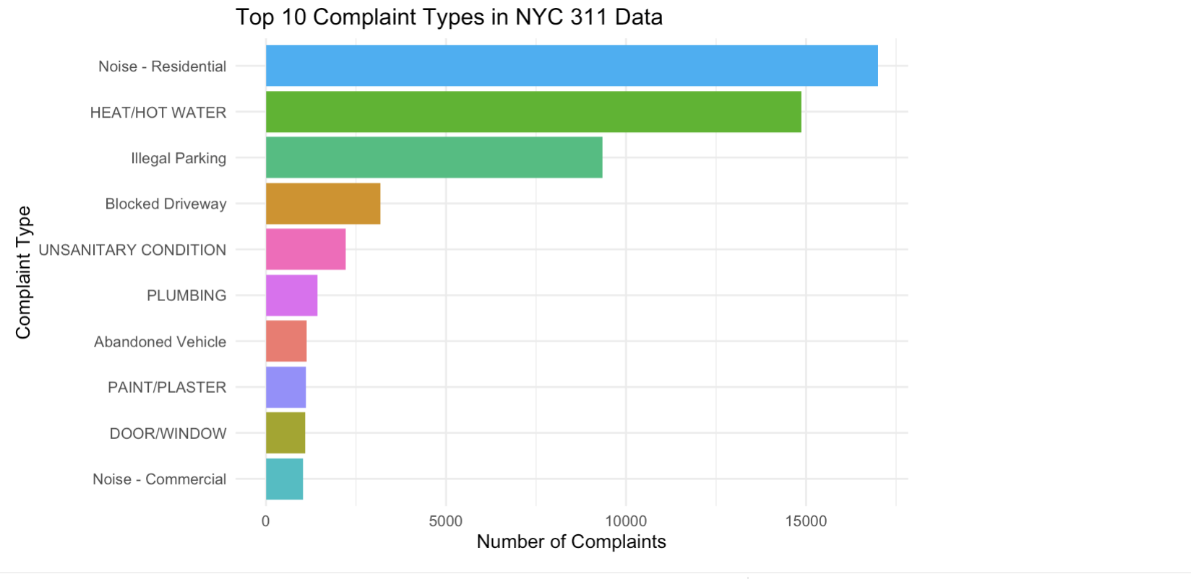
Top 10 Complaint Types

Slide 7
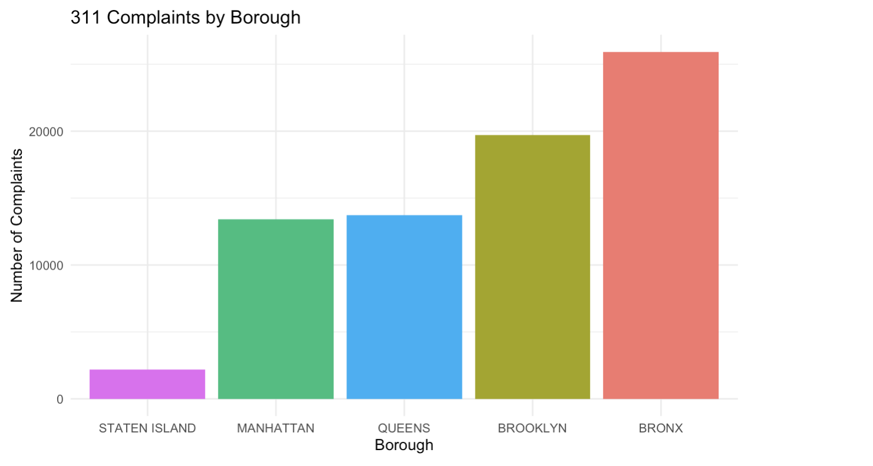
311 Complaints by Borough

Slide 8
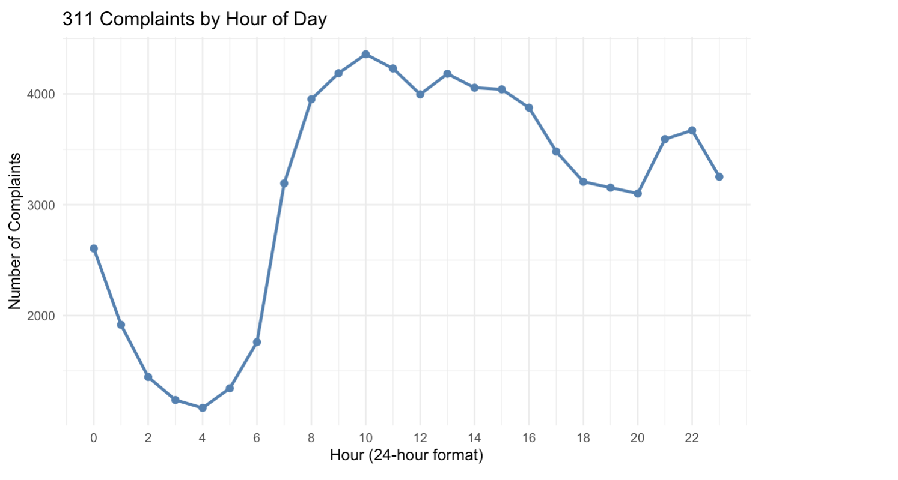
311 Complaints by Hour

Slide 9
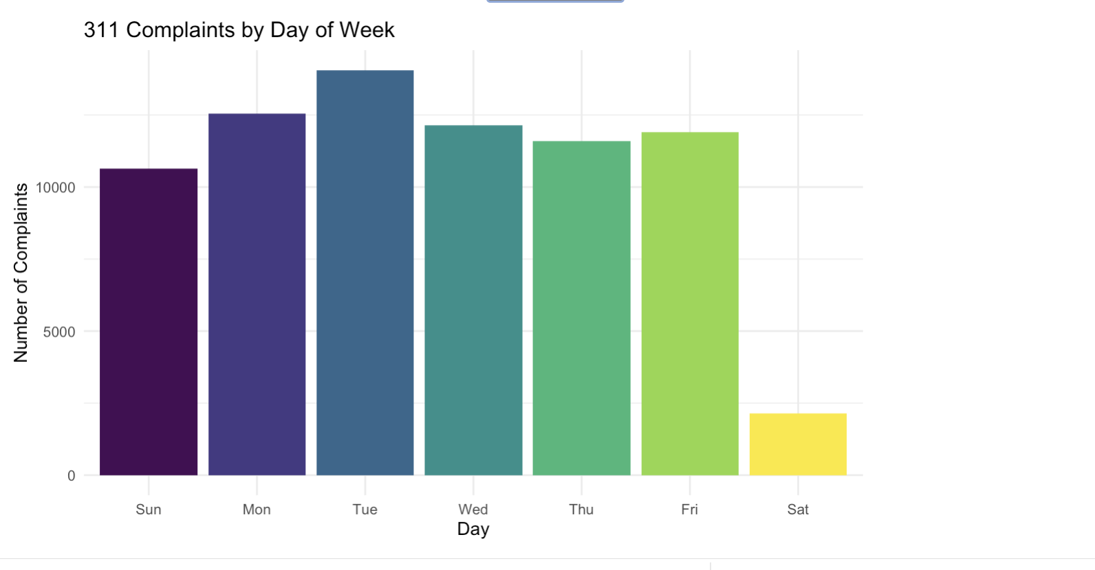
311 Complaints by Day of Week

Slide 10
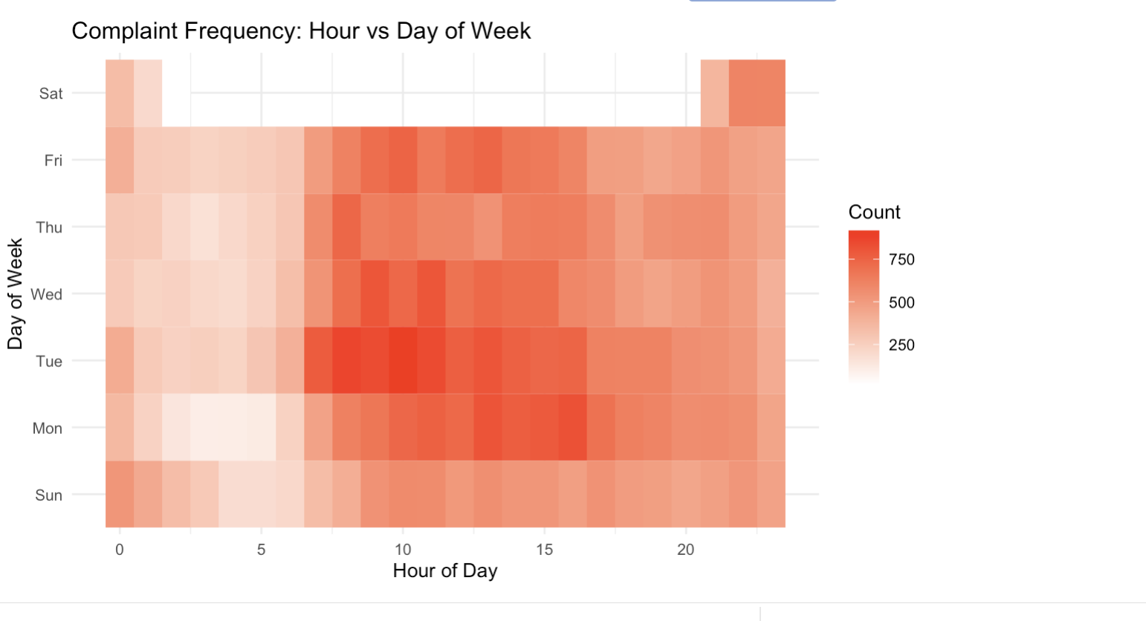
Complaint Frequency Analysis by Day & Hour

Slide 11
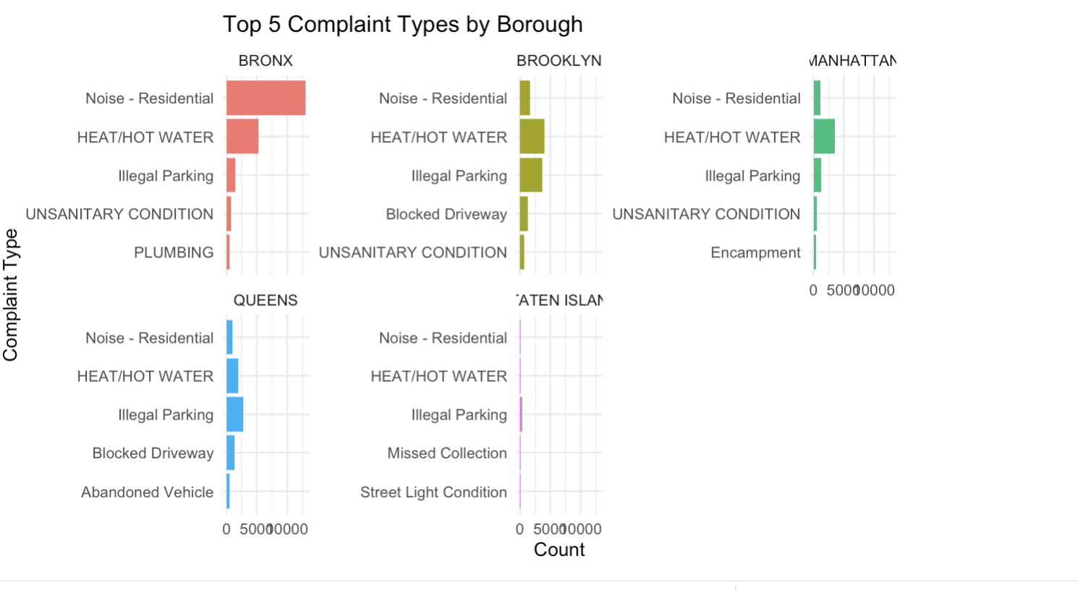
Top 5 Complaints by Borough

Slide 12
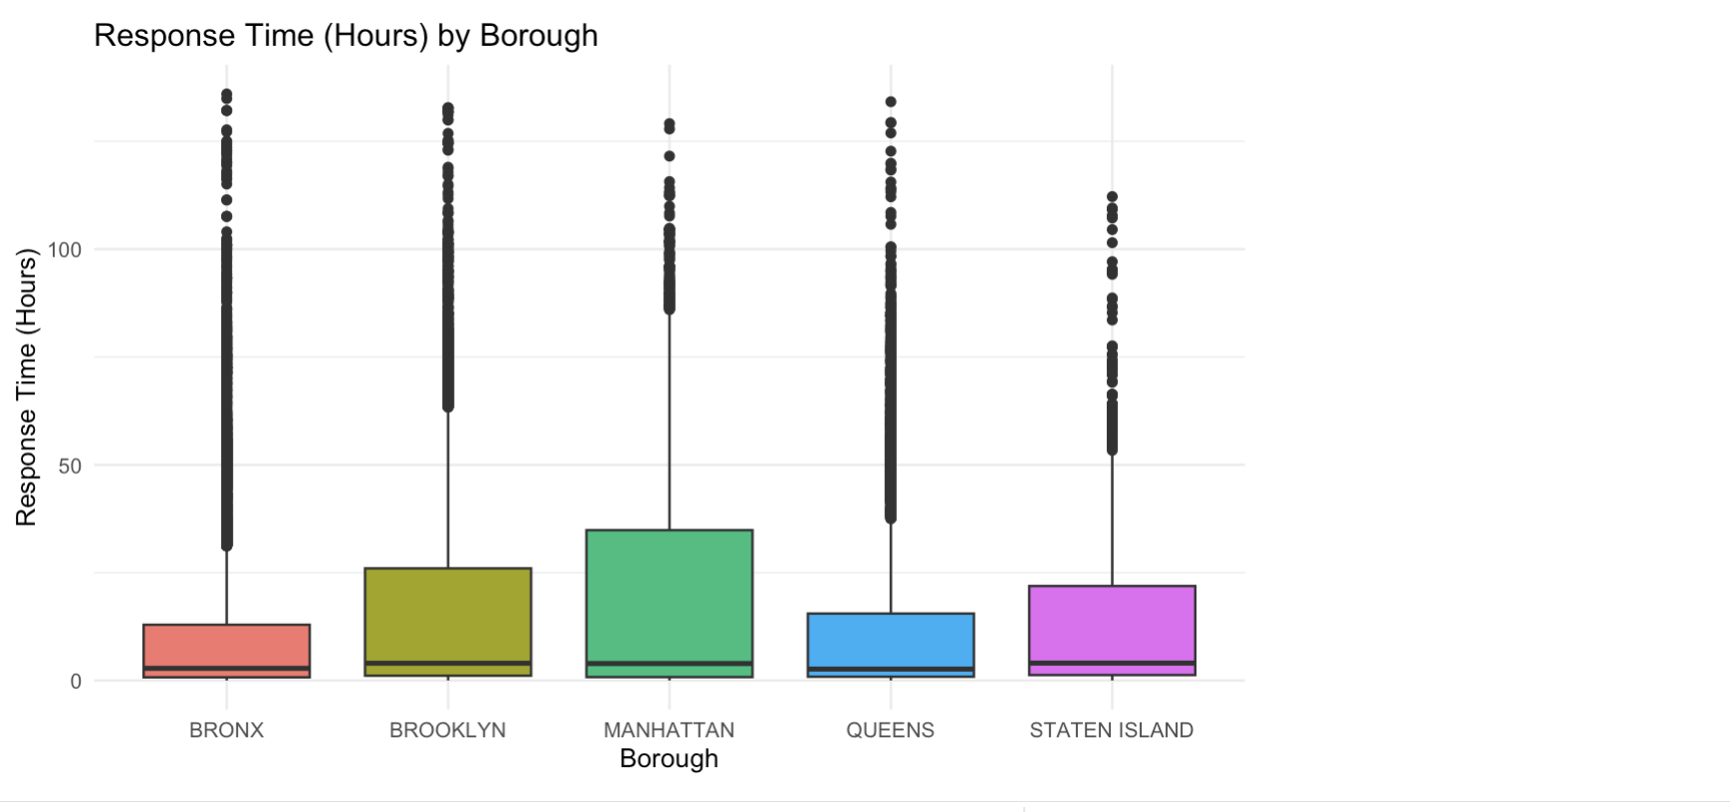
Response Time by Borough

Slide 13
Response Time by Borough
Across all boroughs, NYC 311 requests are typically resolved within a few hours. However, substantial variability exists—particularly in Manhattan and Brooklyn—where a subset of cases experience significantly longer response times. This suggests that while average service levels are strong, targeted interventions may be needed to reduce extreme delays and improve consistency.

Slide 14
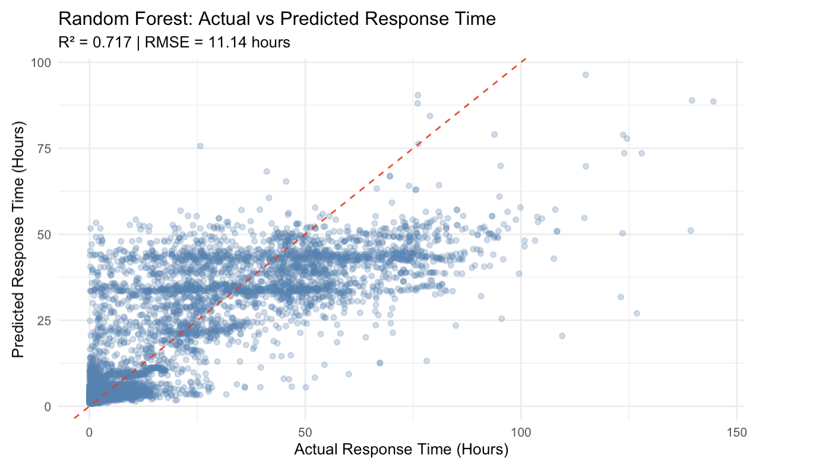
Analyzing Random Forest Data

Slide 15
Predicting Response Time with Machine Learning
R² = 0.71
71% of the variation in response time can be explained by my model's predictors (complaint type, borough, hour, day of week, month).
An R² of 0.71 is strong for real-world municipal data. The remaining 29% of unexplained variance comes from factors not in your dataset
RMSE = 11.14 hours
Predictions are accurate within approximately 0.46 days(about half a day) sufficient for operational triage and resource planning.

Slide 16
Biggest Challenge
The biggest challenge I had in completing. This code was learning how to build, update and modify a Shiny app. The process felt similar to developing a User Experience(UX) application which is quite a challenging feature.
My second challenge was developing meaningful insight from the data. I used three API’s in this project and only one from NYC open data allowed me to get a max of 80000 data points. Since 311 gather thousands of service calls in a day, 80,0000 data pints approximates to a few data of data. With the variety of visualizations, I was able to with trial and error develop meaningful plots.

Slide 17
311 Shiny App
An interactive look at important 311 with a borough focused analysis

Slide 18
References
City of New York. (2025, December 8). 311 service requests from 2010 to present. NYC Open Data. https://data.cityofnewyork.us/Social-Services/311-Service-Requests-from-2010- to-Present/erm2-nwe9/about_data
Géron, A. (2022). Machine learning project checklist. In Hands-on machine learning with Scikit-Learn, Keras, and TensorFlow (3rd ed.). O'Reilly Media.
Grant, C. (2025). NYC 311 requests [Interactive dashboard]. Shiny https://candacegrant2025.shinyapps.io/NYC_311_Requests/
Office of the New York State Comptroller. (2025, May). NYC311 monitoring tool
(Report 3-2026). https://www.osc.ny.gov/files/reports/pdf/report-3-2026.pdf

